Slide 1



Machine Learning
WORKSHOP
A hands-on introduction to Machine Learning
Benyamin Ebrahimpour, PhD
University of Portsmouth London
HTTPS://GITHUB.COM/BENYAMINEMP
7/4/25

Slide 2

CONTENT
Machine Learning
Machine Learning types
Group activity
Cats vs. dogs
Wrap-Up and Takeaway Challenge
01
03
04
05
06
00

Slide 3





01
Machine
Learning
workshop
Machine Learning
Has anyone here used AI today?
Actually, many of these things powered by something called Machine Learning.

Slide 4
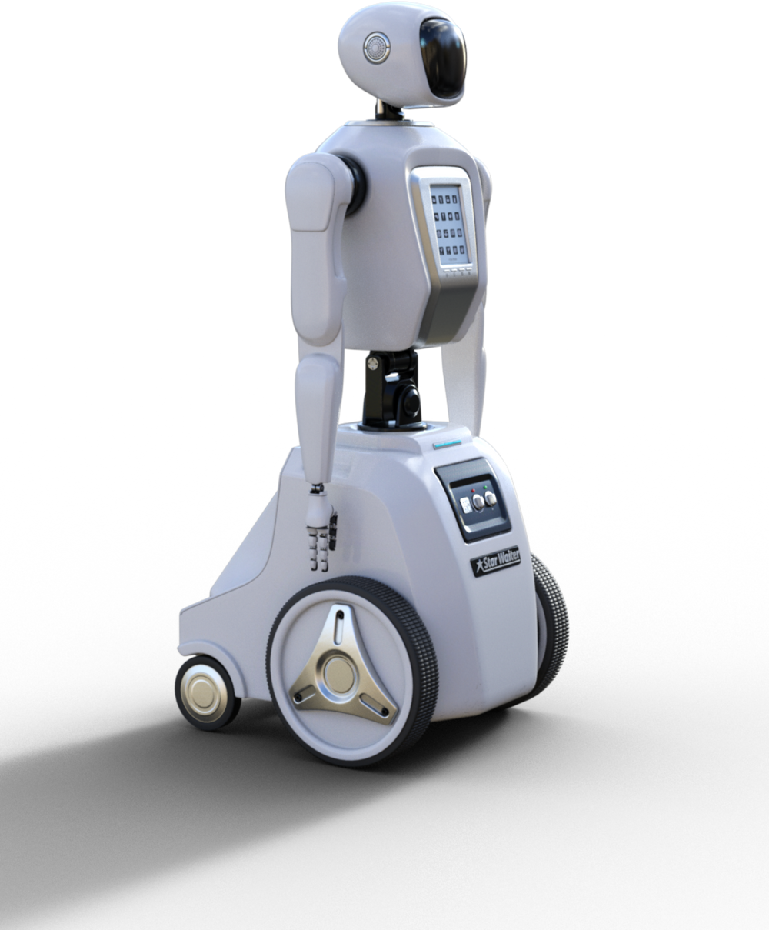
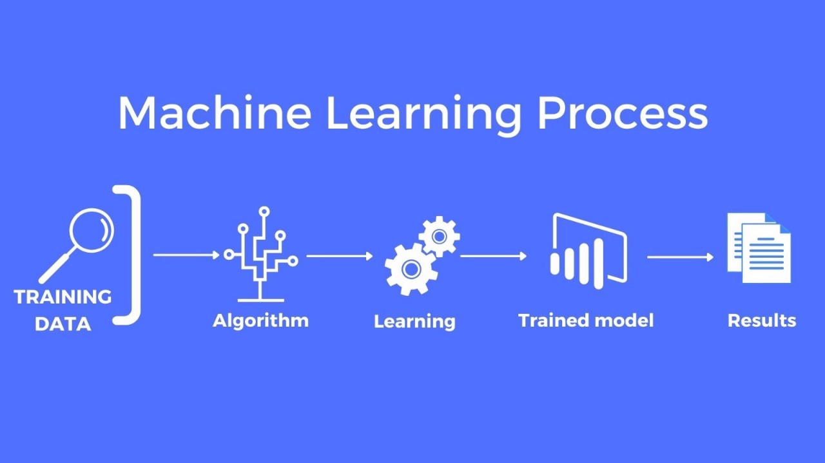
02
Machine
Learning
workshop
Machine Learning
Machine Learning is how we teach computers to learn from examples instead of giving them step-by-step instructions.
For instance:
- Netflix suggesting shows based on your past watching/ratings.

Slide 5
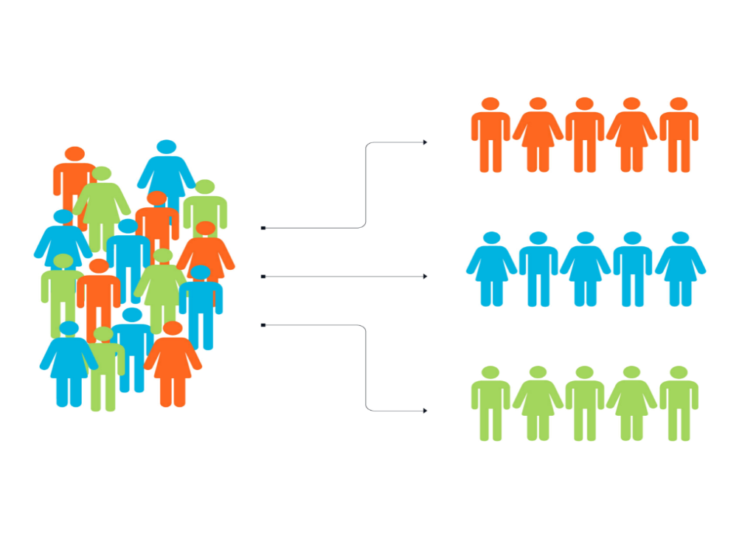
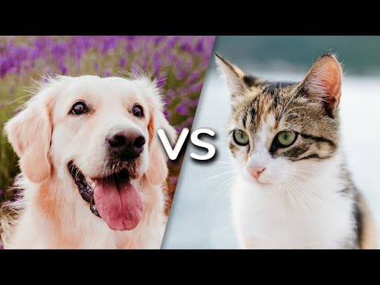
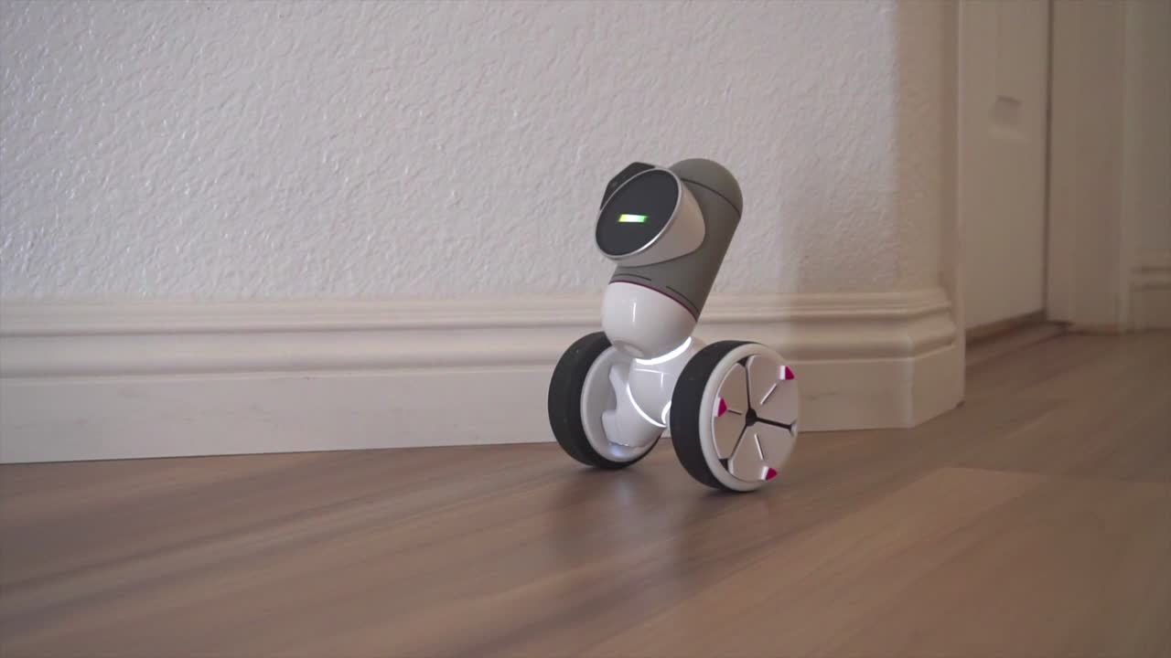
03
Machine
Learning
workshop
Machine Learning Types
Supervised Learning
Un-Supervised Learning
Reinforcement learning
Teaching a computer to tell cats vs dogs using labeled images.
Grouping customers by shopping habits (e.g. who buys similar products).
Teaching a robot to walk.

Slide 6

04
Machine
Learning
workshop
Group Activity:
Be the Machine Learning Model
In pairs or small groups, participants act as a Machine Learning model:
You’re given labeled images
You study the features of “training data”
You are given new images to classify with no labels
You must explain how you made your decision

Slide 7


05
Machine
Learning
workshop
Cats vs. dogs
Google Teachable Machine -No coding required.
GitHub

Slide 8


06
Machine
Learning
workshop
Wrap-Up and Takeaway Challenge
Now, participants should be able to:
Understand basic principles of machine learning.
Identify real-world examples of machine learning.
Engage in thinking like a machine learning trainer.
Access to Google tool / GitHub code for cats vs. dogs image recognition.
Where could machine learning help solve a problem in your job or life?

Slide 9



THANK YOU
contact us
Dr.Benyamin.ebrahimpour@gmail.com

